Slide 1





Concurrency and Transaction Management
Alexander Pittendrigh && James Barrow

Slide 2
ACID
Atomicity
Consistency
Isolation
Durability

Slide 3
Atomicity
All or nothing!
What about Entity Framework?
SaveChanges() is your friend
Starting with EF6 Database.ExecuteSqlCommand() by default will wrap the command in a transaction if one was not already present

Slide 4
Consistency
Databases may only move from one consistent state to another

Slide 5
Isolation
Every transaction must feel like it is the only transaction
In SQL Server locks are used to achieve isolation
READ COMMITTED is the default isolation level for the Microsoft SQL Server Database Engine

Slide 6
Reading
A dirty read happens when one transaction is permitted to read data that has been modified by another transaction that has not yet been committed.
The so-called phantom problem occurs within a transaction when the same query produces different sets of rows at different times.

Slide 7
Isolation Levels
Isolation level | Dirty read | Nonrepeatable read | Phantom
Read uncommitted | Yes | Yes | Yes
Read committed | No | Yes | Yes
Repeatable read | No | No | Yes
Snapshot | No | No | No
Serializable | No | No | No

Slide 8
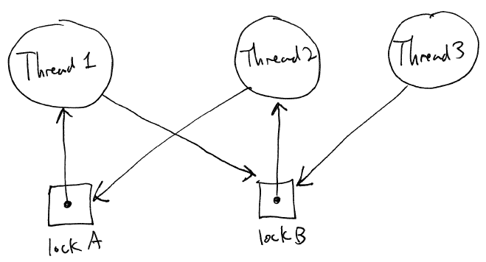
Deadlocking

Slide 9
Durability
All transactions should be permantent

